Slide 1
Normalization
Dr. Sonal Dekhane
ITEC 3200

Slide 2
Functional Dependencies
A relationship between attributes where one attribute (or a group of attributes) determines the value of another attribute in the same table
Example:
Cost of one cookie can determine the price of a box of 12 cookies
(CookiePrice, Quantity) -> BoxPrice
CookiePrice and Quantity are called “determinants”
They determine the BoxPrice
BoxPrice is functionally dependent on CookiePrice and Quantity

Slide 3
Normalization
The process of breaking a table with more than one themes into tables so that each has only one theme
Goal: minimize redundancy and dependency
Tables that are not normalized have modification issues, also called as anomalies
Insertion problems (Addition anomalies)
Modification problems (Update anomalies)
Deletion problems (Deletion anomalies)

Slide 4
Normal Forms
First Normal Form (1NF)
Second Normal Form (2NF)
Third Normal Form (3NF)
Each normal form takes care of an anomaly that the previous NF does not
(Note: There are 4NF and 5NF, but these are very rare cases. Most databases are normalized up to 3NF.)
Defined
By
E.F. Codd

Slide 5
First Normal Form
A table (relation) is in first normal form (1NF) if it meets the definition of a relation, has a primary key and does not contain any repeating field(s)
(Note: this is the definition of a relation, so a table with repeating field(s) is not really a relation.)
For 1NF, ask yourself: Does the table meet the definition of a relation?
If the answer is yes then the table is in 1NF

Slide 6
What is a relation?
Rows contain data about an entity
Columns contain data about attributes of the entity
Cells hold a single value
All entries in a column are of the same kind
Each column has a unique name
Order of columns and rows is unimportant
No two rows may hold identical sets of data

Slide 7
Schema for the CUSTOMER table:
CUSTOMER(CID, Cname, Phone, (OrderNum, Orderdate))
Parenthesis indicate a repeating group
NOTE: This is not really a relation at all.

Slide 8
This table actually contains a 1-many relationship:
CUSTOMER(CID, Cname, Phone, (OrderNum, Orderdate))
Submits
CUSTOMER
ORDER
Submitted by

Slide 9
Create a new table ORDER and move the repeating group to the new table:
CUSTOMER(CID, Cname, Phone)
ORDER(OrderNum, Orderdate, CID)
FK CID → CUSTOMER
Add the foreign
key for the 1-Many
relationship.
Submits
CUSTOMER
ORDER
Submitted by

Slide 10
The normalized table(s) are:
CUSTOMER(CID, Cname, Phone)
ORDER(OrderNum, Orderdate, CID)
FK CID → CUSTOMER

Slide 11
Activity
Is the following table in 1NF? Why or why not? If not, convert it into 1NF
STUDENT(StudentNumber, StudentName, Major, (AdviserID, AdviserName, AdviserDiscipline))

Slide 12
Second Normal Form
A table is in second normal form if:
It is in 1NF
All non-key attributes are determined by the entire primary key
If primary key is a composite key, no attribute should be determined by just a part of the composite key

Slide 13
Example: ORDERLINE table
ORDERLINE(OrderNum, PartNum, PartDescr, Qty)
The problem is this:
ORDERLINE(OrderNum, PartNum, PartDescr, Qty)

Slide 14
Converting ORDERLINE to 2NF:
ORDERLINE(OrderNum, PartNum, PartDescr, Qty)
ORDERLINE(OrderNum, PartNum, Qty)
FK PartNum -> PART
PART(PartNum, PartDescr)
Convert to 2NF

Slide 15
To convert to 2NF:
Make a new table having the determinant, say D, as the key.
Move the column(s) dependent on D into the new table.
Leave D in the original table as a primary and foreign key.
Give the new table a meaningful name.

Slide 16
A note about 2NF:
If the primary key of the table consists of just one column, it is automatically in 2NF.
Example:
CUSTOMER(CID, Cname, Phone)
this table is in 1NF because there are no repeating fields and it meets the definition of a relation with a primary key
this table is in 2NF because its key consists of just one column

Slide 17
Activity
Convert into 2NF
DEPARTMENT(DeptID, ProjectID, DeptName, ProjectName)
Given: ProjectID ->ProjectName

Slide 18
Third Normal Form
A table is in third normal form (3NF) if it is in second normal form and if all of the columns are dependent only on the primary key (no other columns).

Slide 19
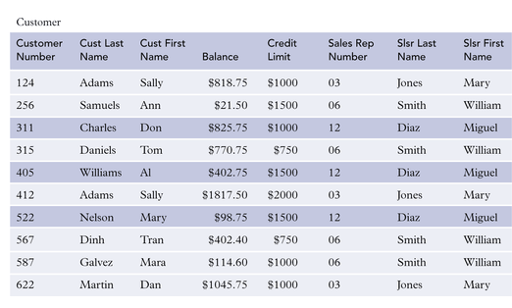
Customer Table not in 3rd Normal Form

Slide 20
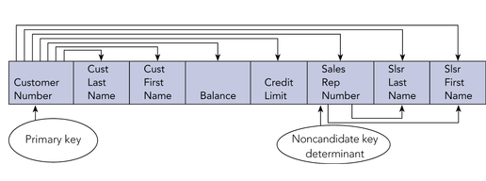
Dependencies in Customer Table
Sales Rep Number Slsr Last Name, Slsr First Name
Violates
3NF

Slide 21
To convert to 3NF, do the same procedure as for 2NF:
Make a new table having the determinant, say D, as the key.
Move the column(s) dependent on D into the new table.
Leave D in the original table.
Give the new table a meaningful name.
D becomes a foreign key (references the new table.)

Slide 22
Converting CUSTOMER to 3NF:
Violates
3NF
CUSTOMER(CNum, Cname, …. SRepNum, SrepLast, SrepFirst)
SALESREP(SRepNum, SrepLast, SrepFirst)
CUSTOMER(CNum, Cname, …. SRepNum)
FK SRepNum → SALESREP
Convert to 3NF

Slide 23
Another way to remember….
A table is in 3NF if every non-key attribute is dependent on the key, the whole key, and nothing but the key!

Slide 24
Activity
Convert to 3NF
EMPLOYEE(EmployeeNum, EmployeeName, DepartmentNum, DepartmentName)
Given: EmployeeNum -> (EmployeeName, DepartmentNum, DepartmentName)
Given: DepartmentNum -> DepartmentName

